Slide 1
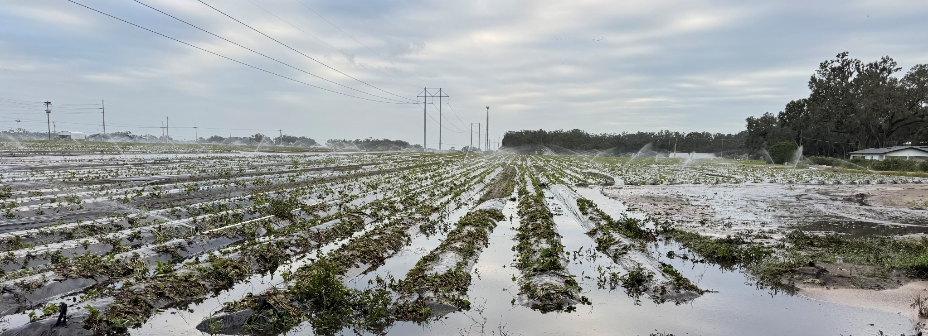

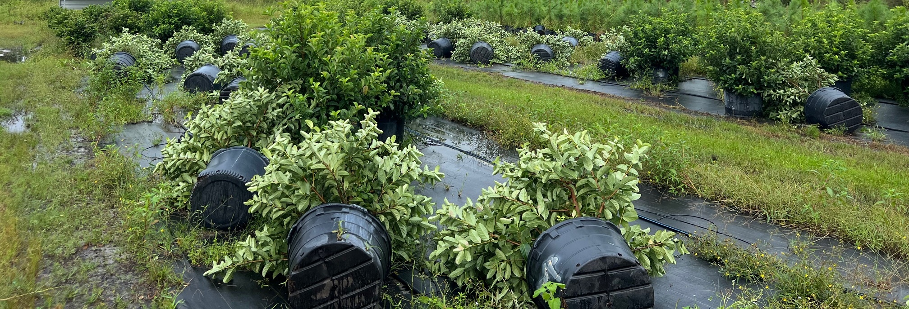
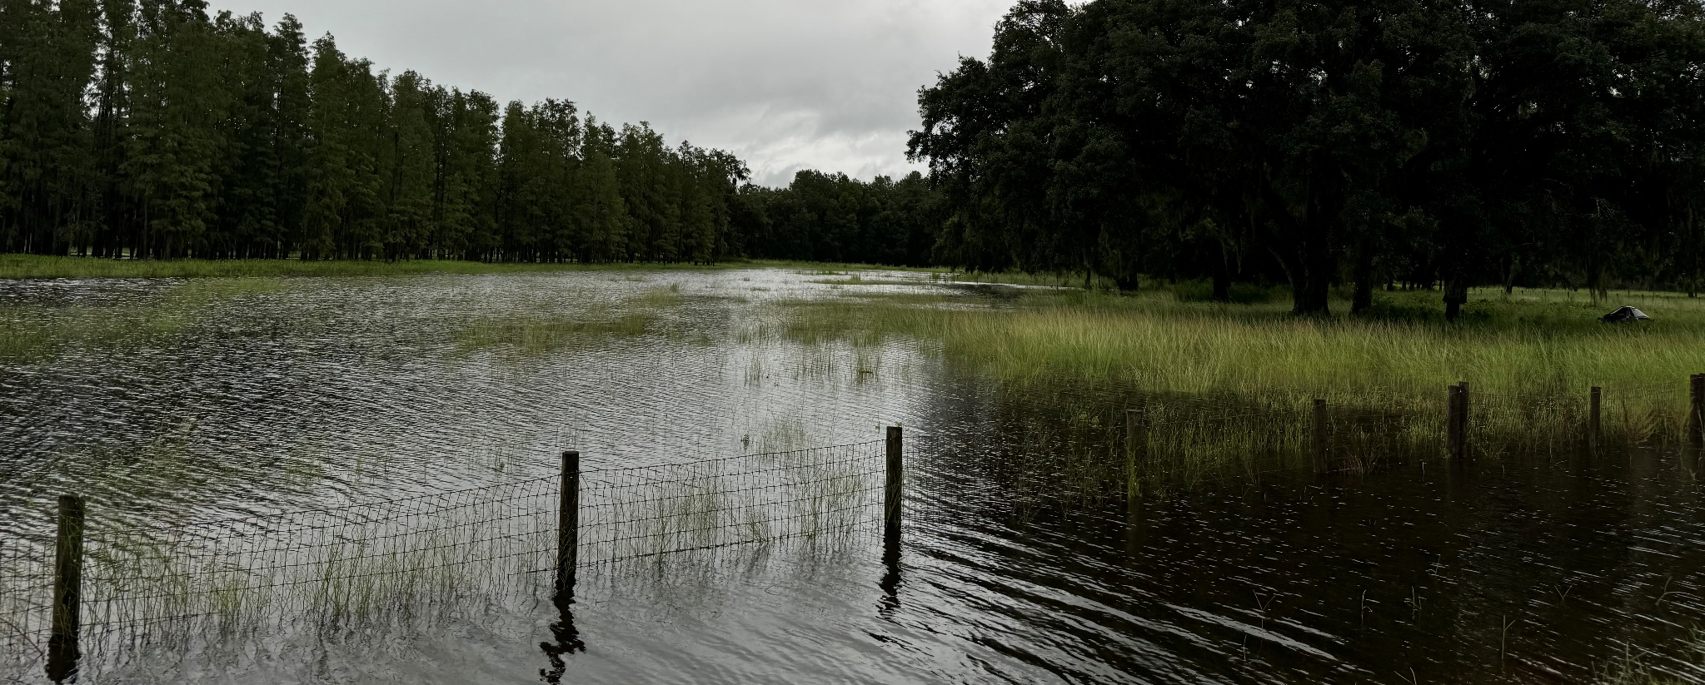
Agricultural Impacts of Disaster Events and Data Tools for Threat Assessment
Prepared for 2025 FDACS SART Planning Workshop
DR. CHRISTA D. COURT, ASSOCIATE PROFESSOR
DEPARTMENT OF FOOD AND RESOURCE ECONOMICS
UF/IFAS ECONOMIC IMPACT ANALYSIS PROGRAM
UNIVERSITY OF FLORIDA
May 28, 2025
Photo courtesy of survey respondent.

Slide 2

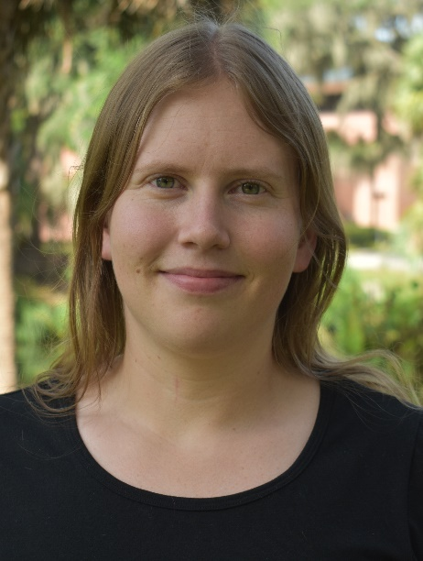




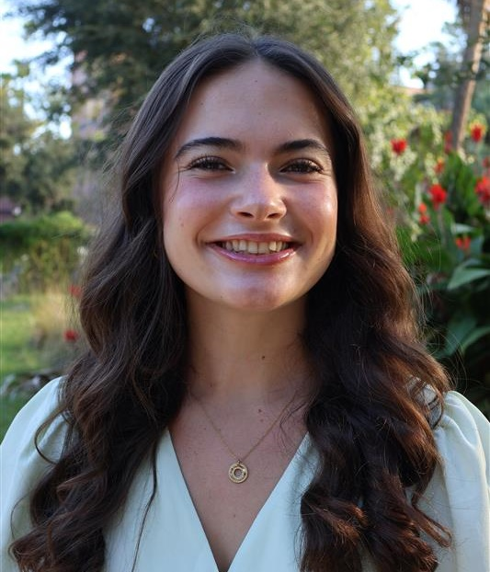
UF/IFAS Economic Impact Analysis Program
Administrative Staff
Research Faculty
Integrated research and extension program housed within the Food and Resource Economics Department
Expertise in the areas of regional economic modeling, economic impact analysis, economic contribution studies, disaster impact analysis
Provide technical assistance to industry groups, academic units, government agencies, and local communities.
Conduct sponsored research projects involving detailed analyses of particular industries, regions, or situations.
Christa Court
Director
Kelsey McDaid
Research
Coordinator
Xiaohui Qiao
Research Asst. Prof.
Graduate Research Assistants
Student Assistant
Roberto Koeneke
Youmin Li
Liam Corcoran
Brooke Ulrich

Slide 3
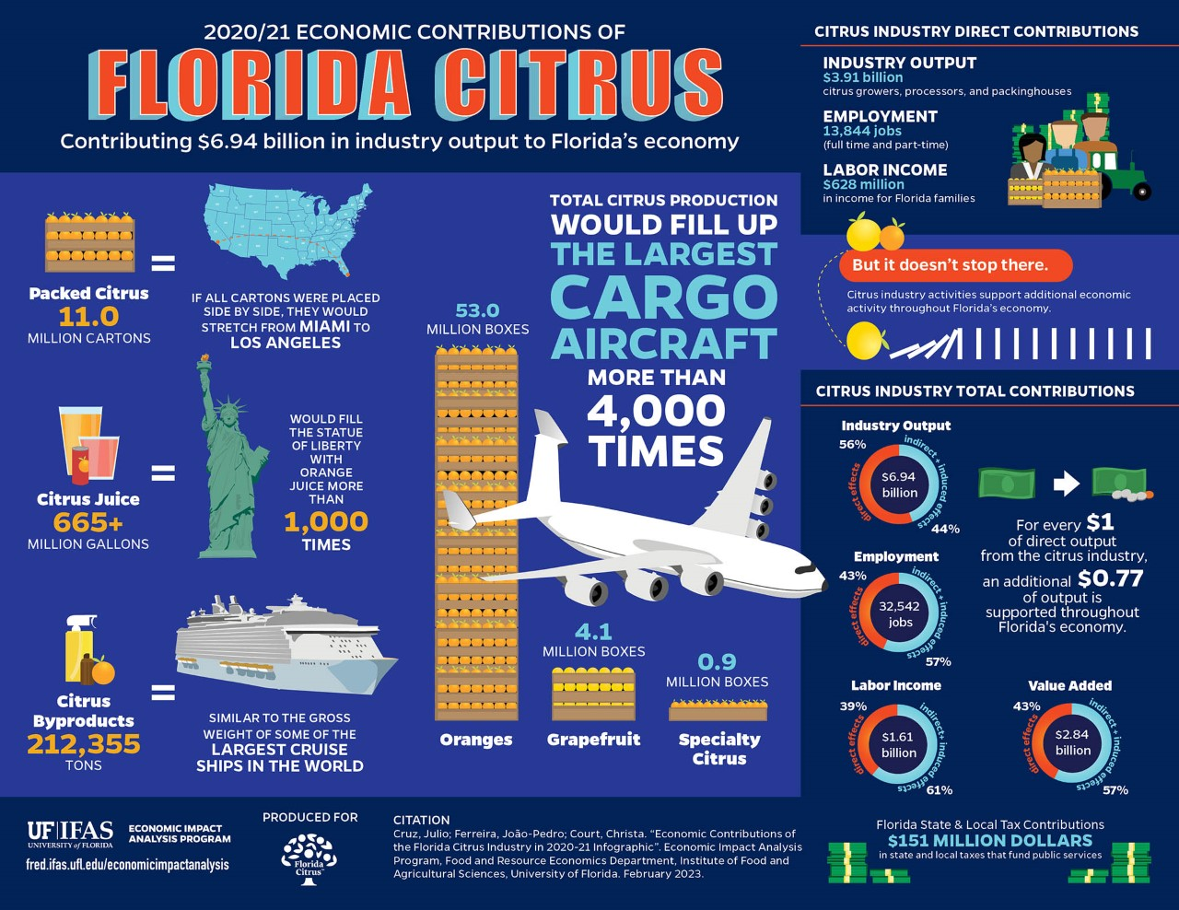


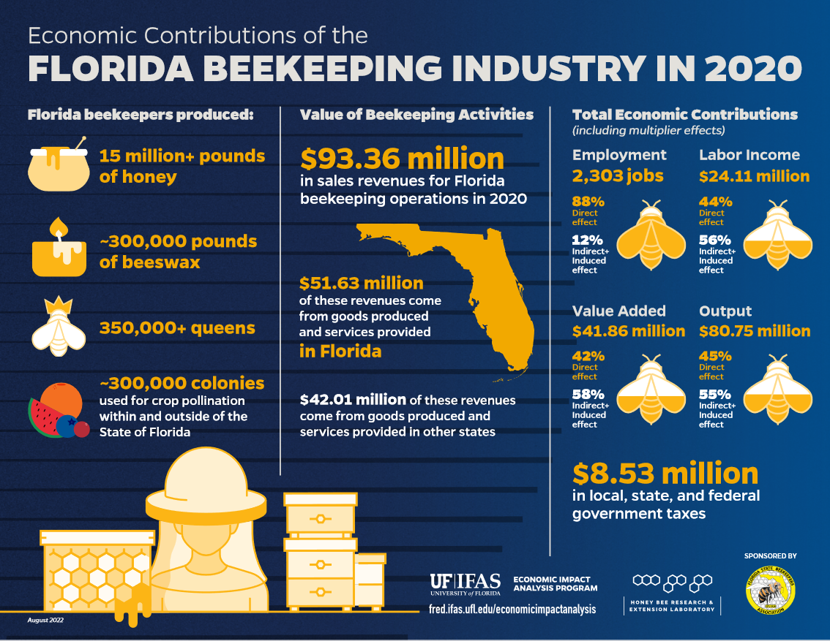


Regional Economic Analysis https://go.ufl.edu/eiap
Production Agriculture
Other Industries
Local Economic Development

Slide 4

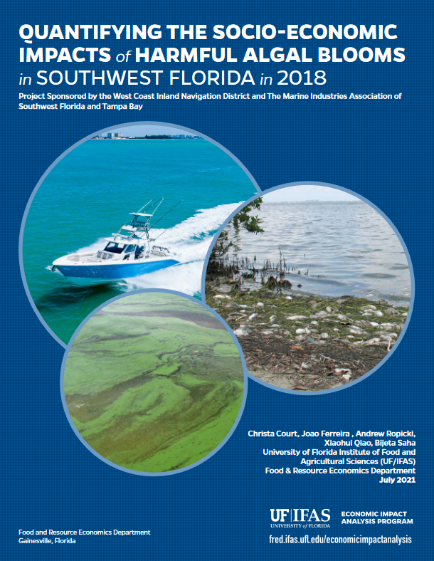

Disaster Impact Analysis https://go.ufl.edu/disasters
Rapid Assessment of Agricultural Losses
Water Quality
Other

Slide 5
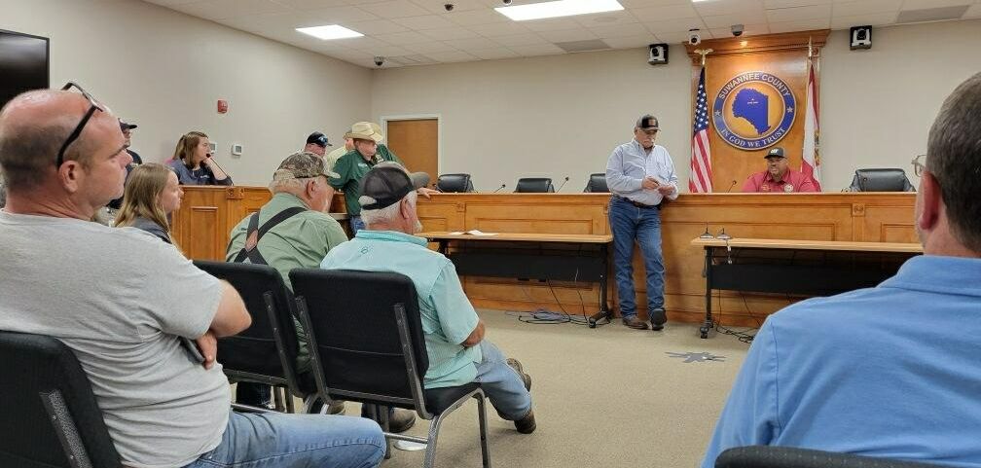
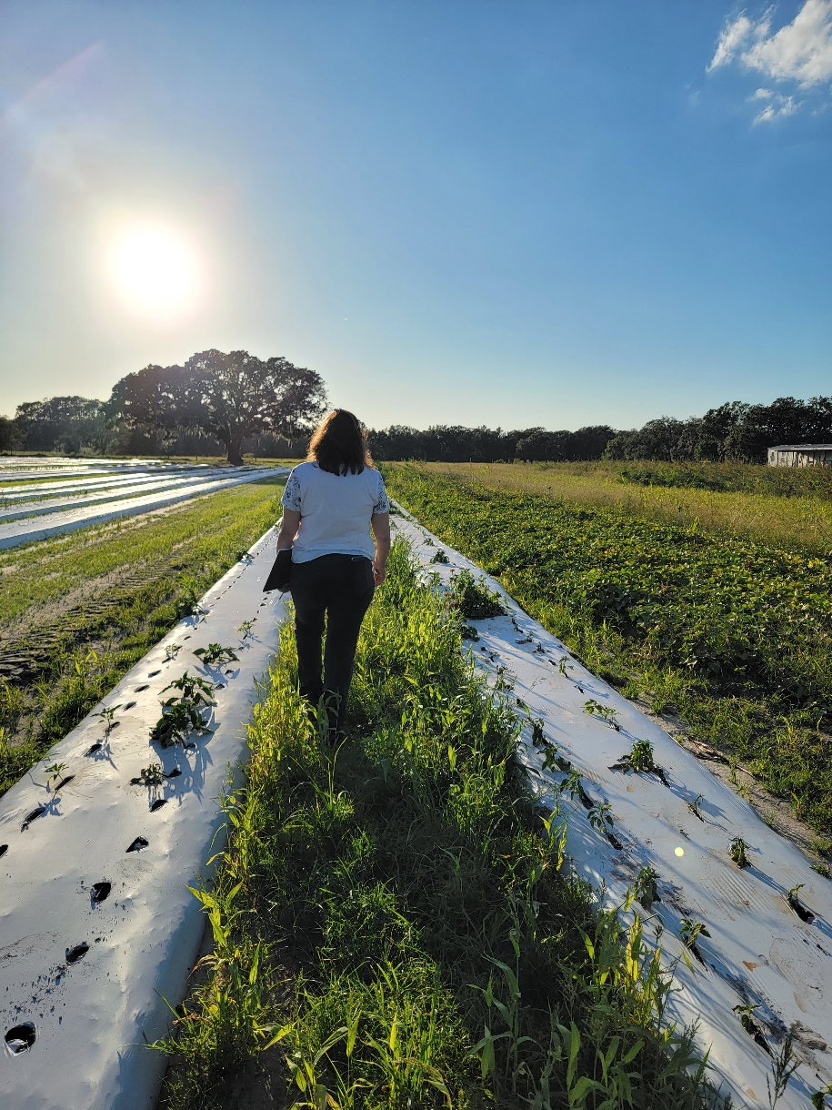
UF/IFAS Involvement in Disaster Assessment
Attend producer meetings to hear first-hand about needs and impacts
Some extension agents and faculty in impacted areas visit farms and other sites to assess damages
UF/IFAS Economic Impact Analysis Program completes a preliminary and final assessment of agricultural losses and damages to production agriculture
Photo Source: Lisa House and Christa Court

Slide 6
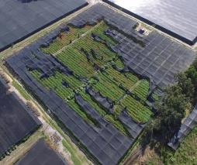
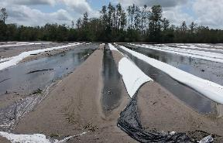
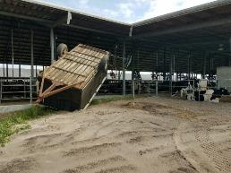
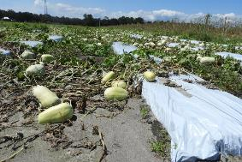
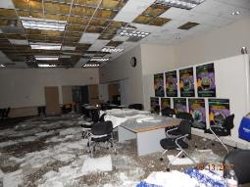

Many Types of Agricultural Assets at Risk
Standing annual and perennial crops
Live animals
Forest inventory
Nursery/greenhouse structures
Irrigation systems
Roads, ditches, stormwater impoundments
Livestock and aquaculture facilities
Farm machinery
Farm homes and office buildings
Packinghouses and processing facilities
Research, extension, and teaching facilities
Photo Source: UF/IFAS

Slide 7
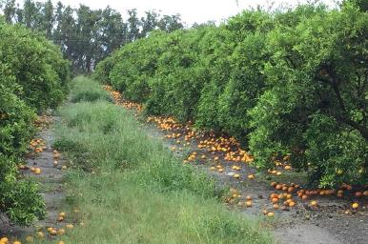
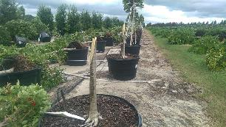
Important Considerations for Measuring Agricultural Impacts of Disaster Events
Agriculture is a seasonal activity
→ when the event happens matters
Sectoral impacts can vary widely
→ what the event impacts matters
Short-term impacts vs. Medium and Long-term impacts
→ not all impacts are immediately observable
Direct vs. Indirect impacts
Heavy reliance on operating loans and seasonal nature of expenditures for crop and livestock production matter
Forward and backward linkages to other food system activities
Photo Source: UF/IFAS
Photo Source: UF/IFAS

Slide 8
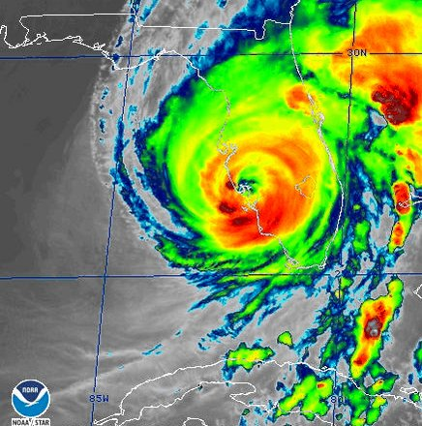
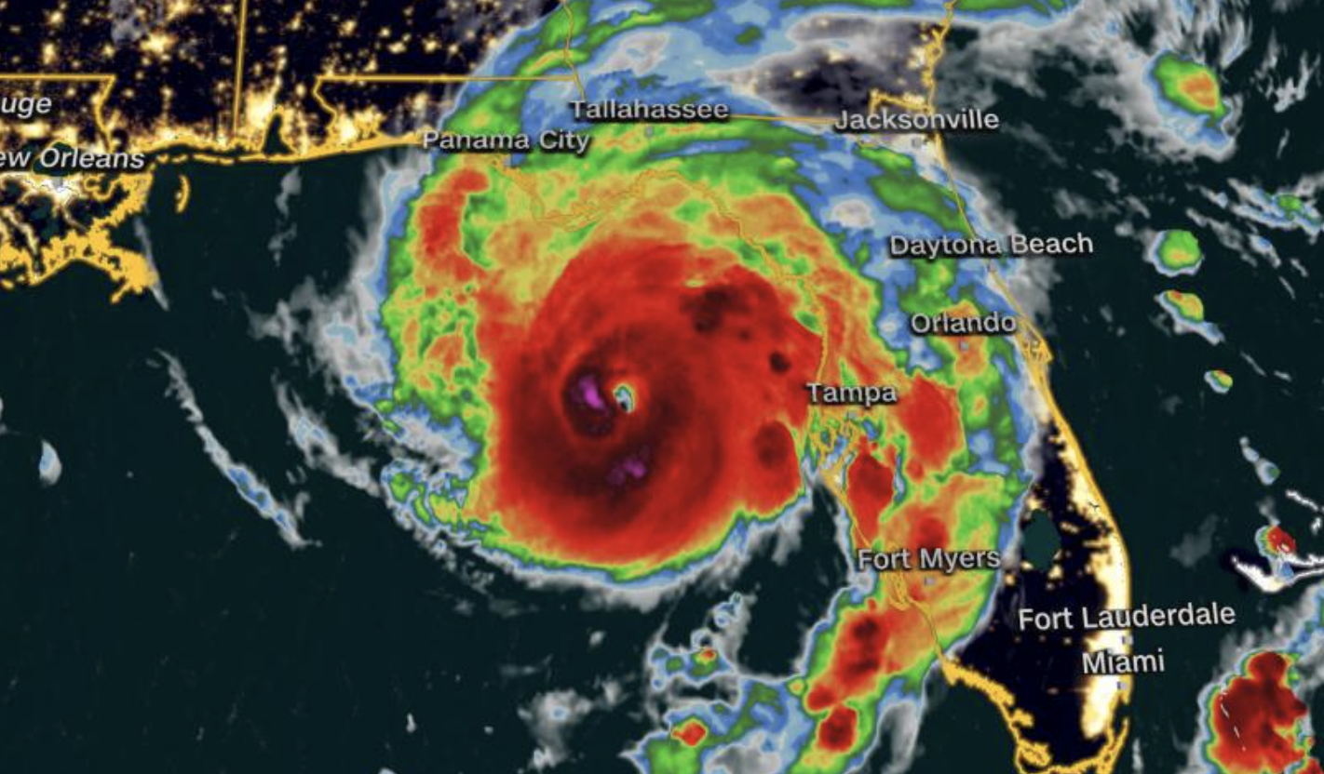
Previous Work on Tropical Cyclones
Hurricane Irma (2017)
Category 3
Hurricane Michael (2018)
Category 5
Hurricane Ian (2022)
Category 4
Hurricane Idalia (2023)
Category 3
First assessment for UF/IFAS
Windshield surveys
Strong assumptions on loss %
Harmonized collection of data
Struggles with power/internet
Survey improvements
Addition of precipitation and flooding within analyses
Additional survey improvements
Spanish translations
Agricultural Losses:
~$1.313 billion
Agricultural Losses:
~$138 million
Agricultural Losses:
~$1.035 billion
Agricultural Losses:
~$276 million
Losses should not be compared across events due to changes in methodology over time.

Slide 9
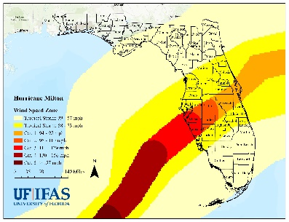
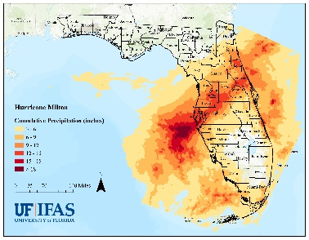

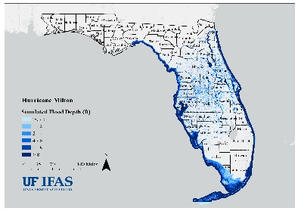
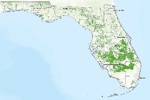




Methodology for Estimating Agricultural Losses
Wind Speed
Event Data
Precipitation
Flood Depth
Statewide estimates of agricultural losses
Adapted from:
FAO Damage and Loss Methodology
Crops, Livestock,
Aquaculture
Baseline Data
Crop Growth Stage
Value Per Acre
Loss Percentage
Surveys and Reports

Slide 10
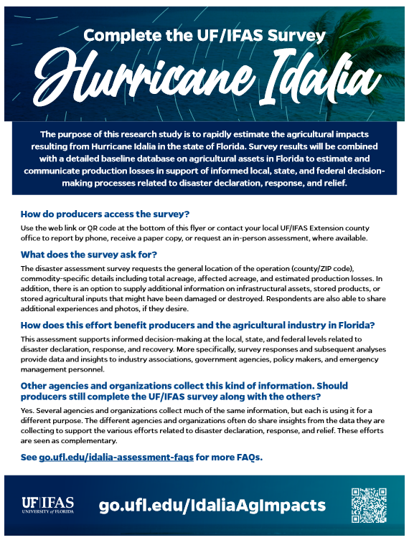
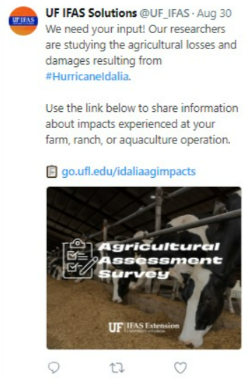
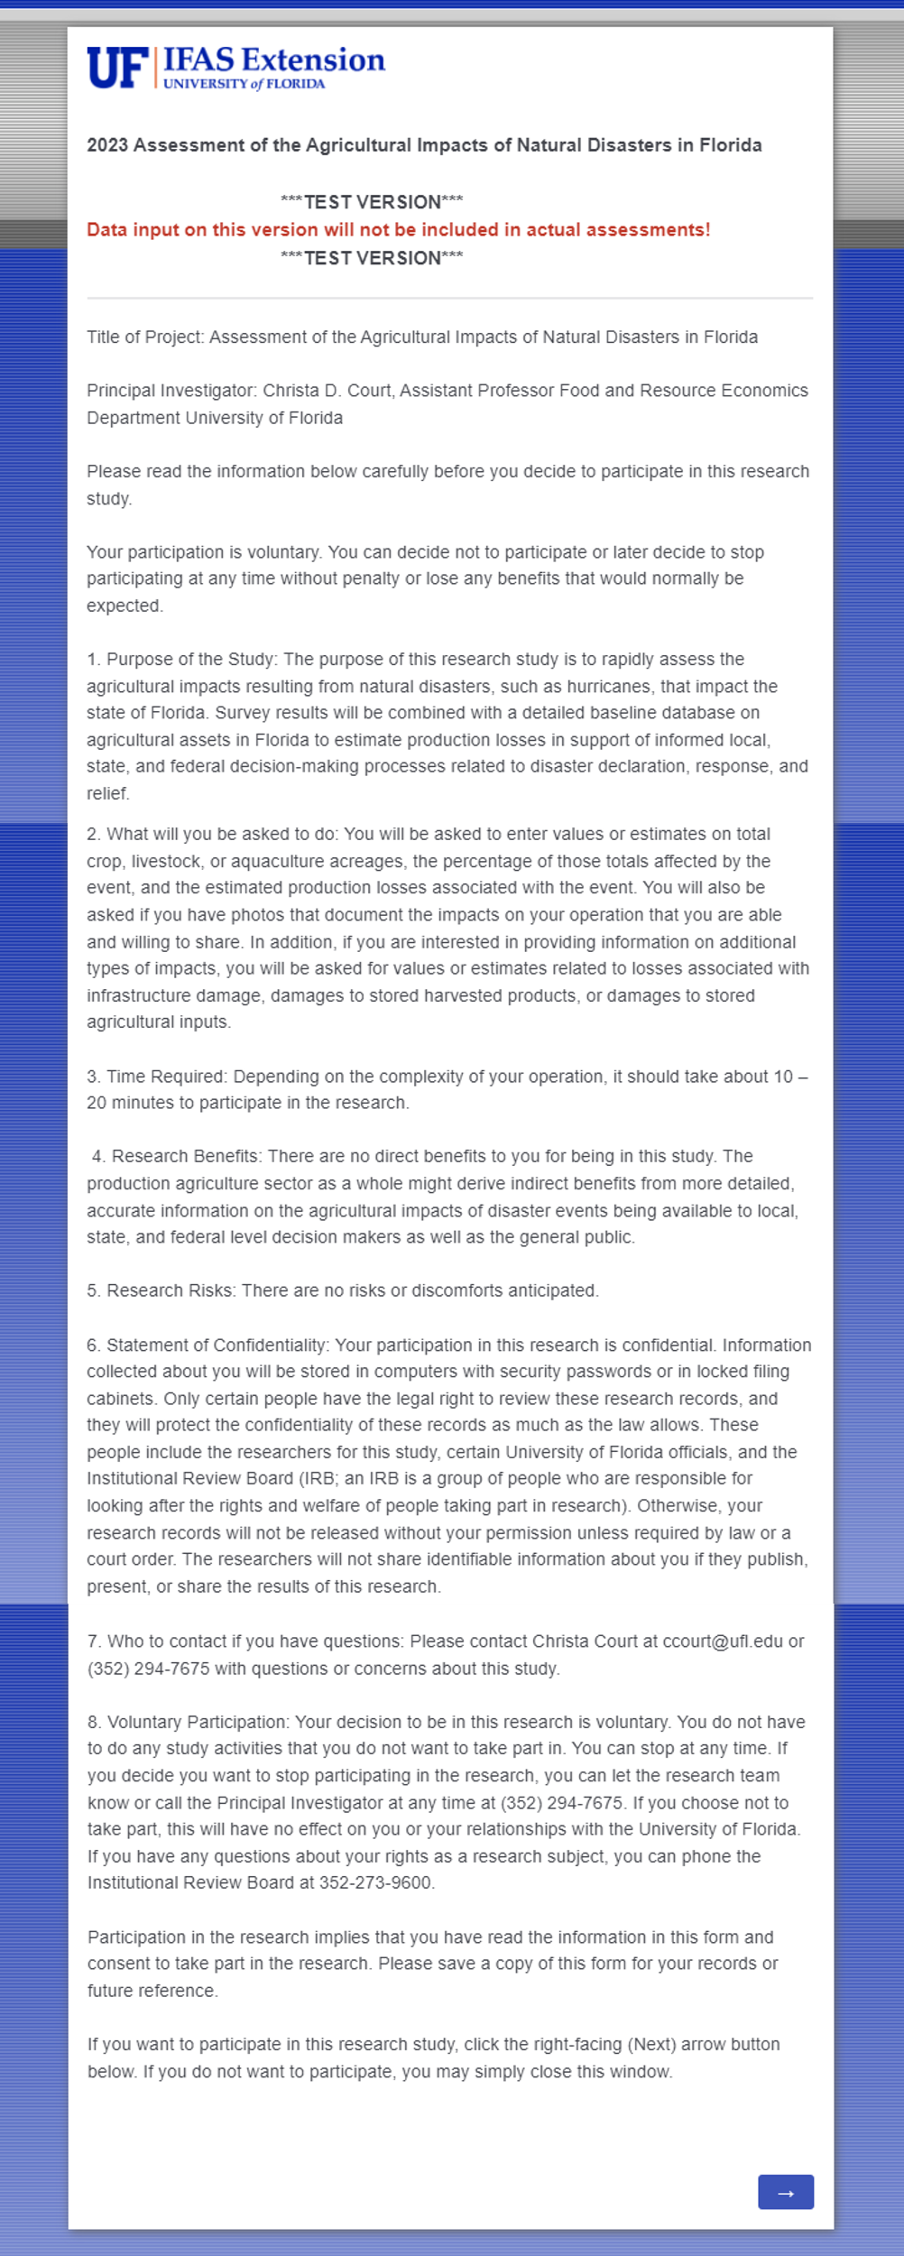
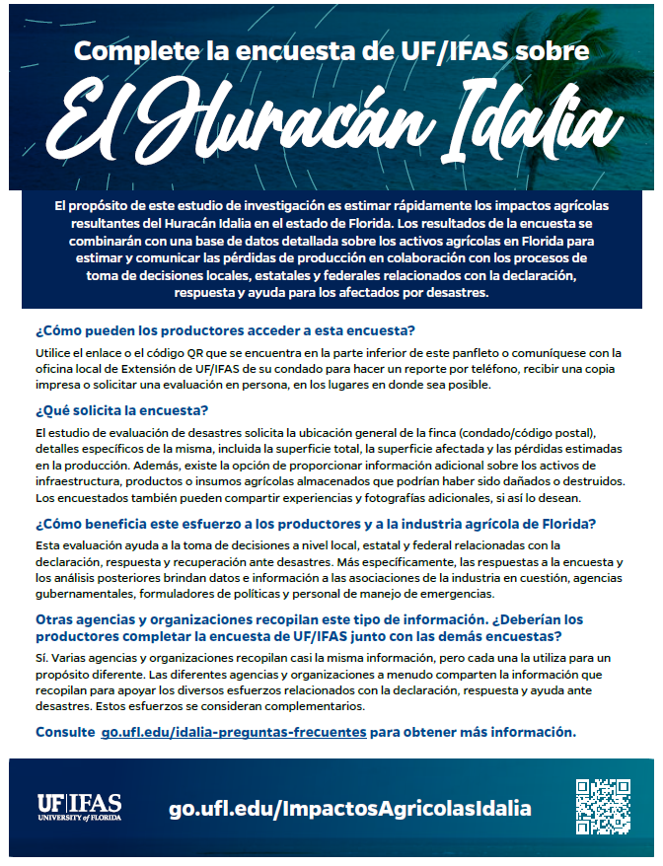
UF/IFAS Assessment Distributed Widely with Assistance from Extension, Industry Associations, and Government Agencies
Flyers with Short Weblinks and QR codes
Social Media Posts
Survey Consent Form

Slide 11
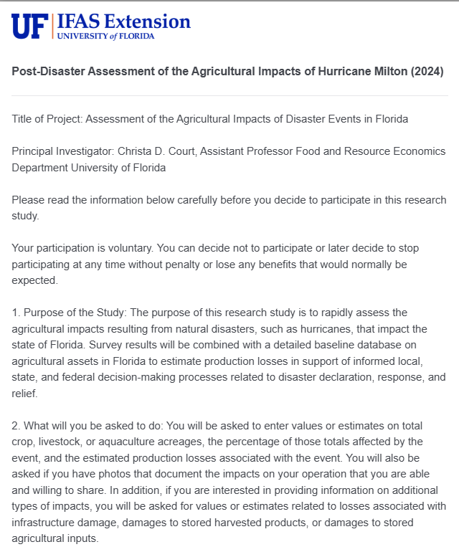
Survey Design
Basic Information
Disaster type
County
Observer Information
Agricultural commodity group
Detailed crop(s) affected
Total planted area (acres)
Percentage of planted area completely destroyed (100% loss)
Percentage of planted area damaged but not completely destroyed
Estimated production loss on damaged acreage (%)
Amount of harvested products stored on farm
Percentage of stored products damaged
Fruits and nuts
Vegetables, melon, and potatoes
Field crops
Greenhouse/nursery
Citrus
Livestock
Animal Products
Aquaculture
Stored inputs damages
Detailed type affected
Quantity on farm
Percentage of stored inputs damaged
Detailed animal(s) affected
Number on farm
Number injured
Number lost or died
Amount of animal products produced on farm last year
Percentage of annual production lost in disaster (%)
Infrastructure and asset damages
Detailed type affected
Quantity on farm
Quantity destroyed
Comments and pictures

Slide 12
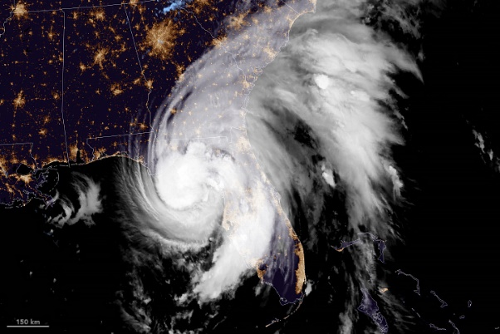
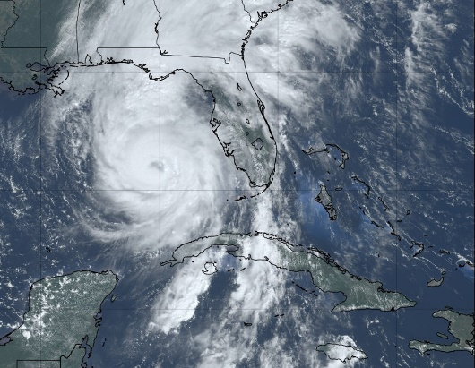
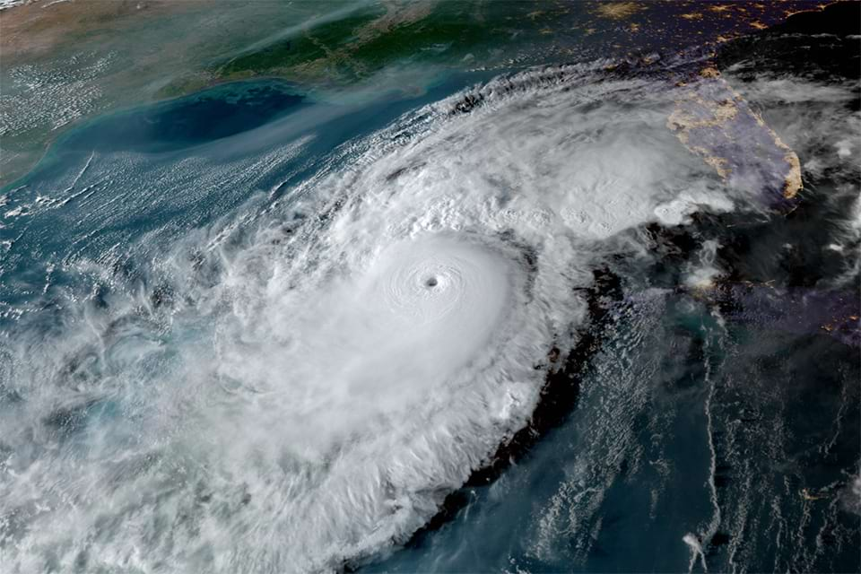
Overview of 2024 Atlantic Hurricane Season in Florida
~7 weeks
~2 weeks
Hurricane Debby
Category 1
Hurricane Helene
Category 4
Hurricane Milton
Category 3
Landfall on August 5, 2024, near Steinhatchee, FL
4 counties experienced hurricane force winds
34 additional counties experienced tropical storm-force winds
Landfall on September 26, 2024, near Perry, FL
8 counties experienced hurricane force winds
55 additional counties experienced tropical storm-force winds
Landfall on October 9, 2024, near Siesta Key, FL
14 counties experienced hurricane force winds
43 additional counties experienced tropical storm-force winds
Photo Source: NOAA

Slide 13
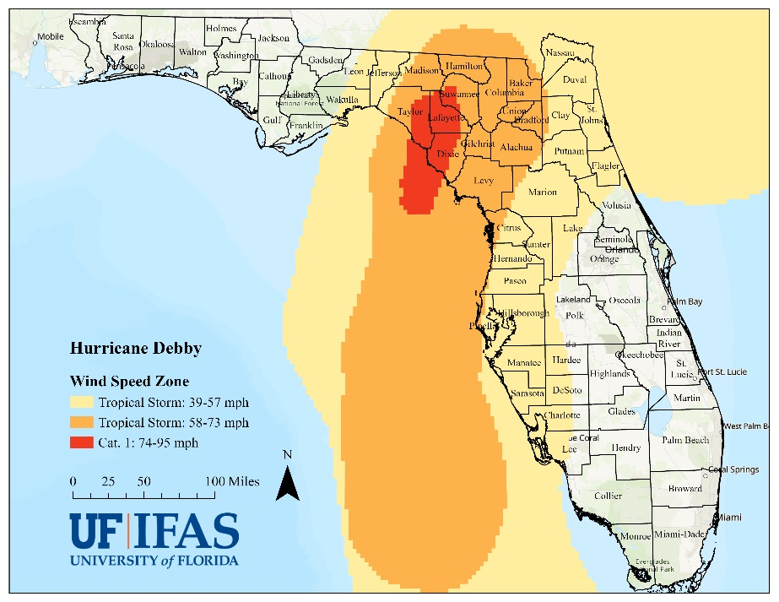
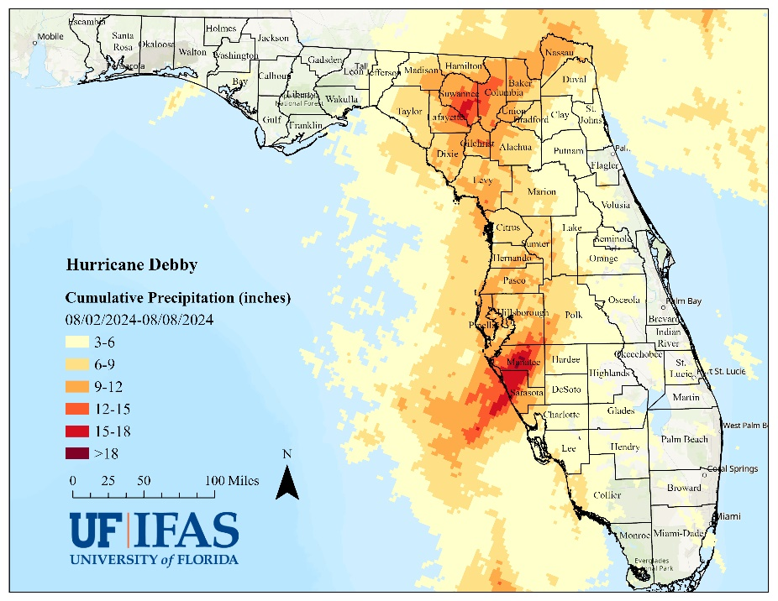
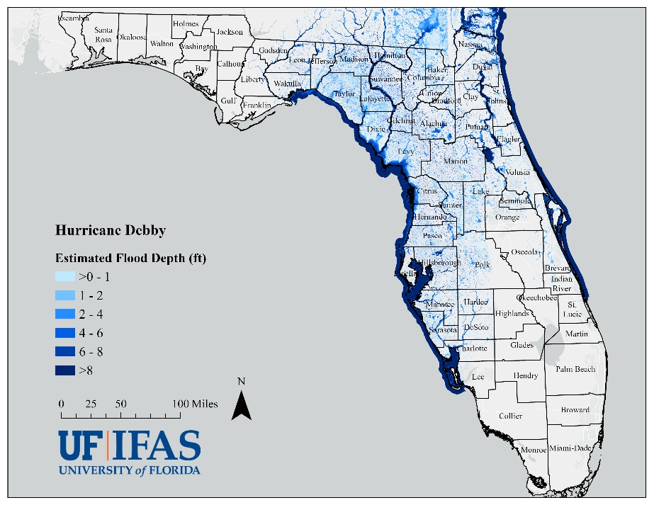
Hurricane Debby Characteristics
Figure 1. Wind swath pattern of Hurricane Debby as it impacted Florida.
Source: Geospatial data on the wind swath of Hurricane Debby are derived
from NOAA NHC (https://www.nhc.noaa.gov/gis/).
Figure 2. Cumulative precipitation totals in Florida (August 2-8, 2024).
Source: Precipitation data are derived from NOAA National Weather Service Quantitative Precipitation Estimate (QPE) Data (https://water.weather.gov/precip/download.php).
Figure 3. Estimated flood inundation depth caused by Hurricane Debby in Florida.
Source: Estimated flood inundation data are retrieved from Pacific Northwest National Laboratory’s Rapid Infrastructure Flooding Tool (https://open-rift-pnnl.hub.arcgis.com/maps/0a38c4d97a6b47369de20fb0c59231c6/about).

Slide 14
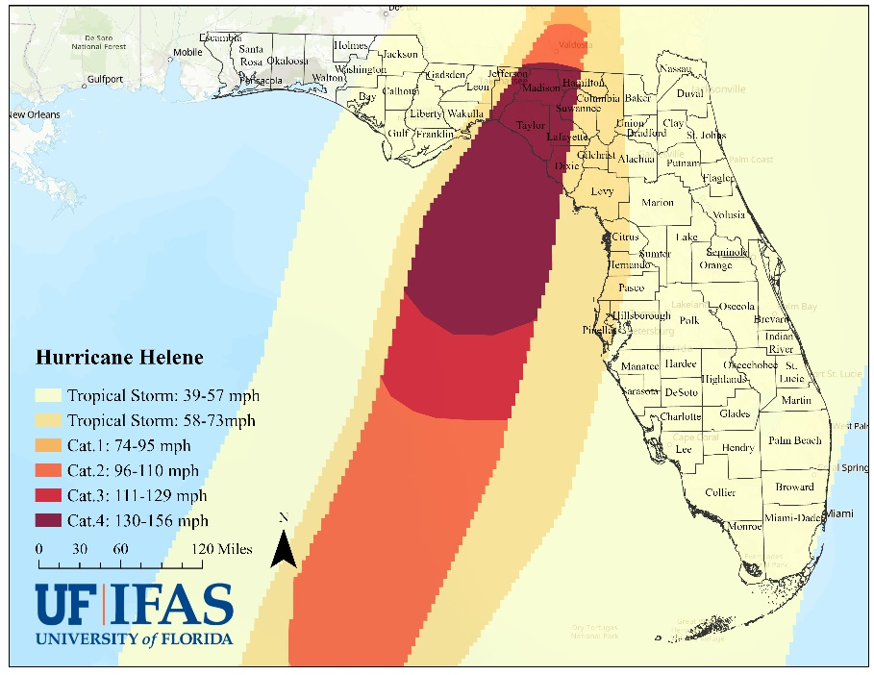
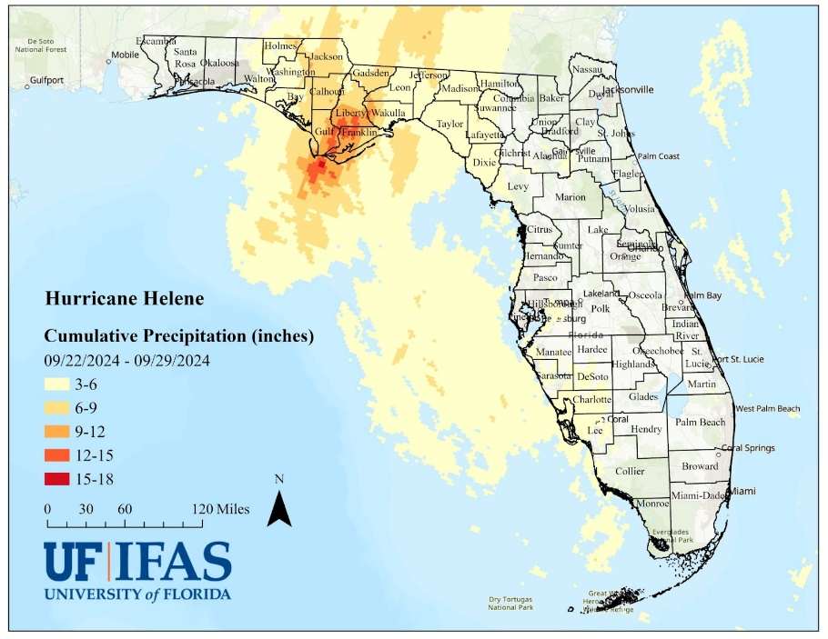
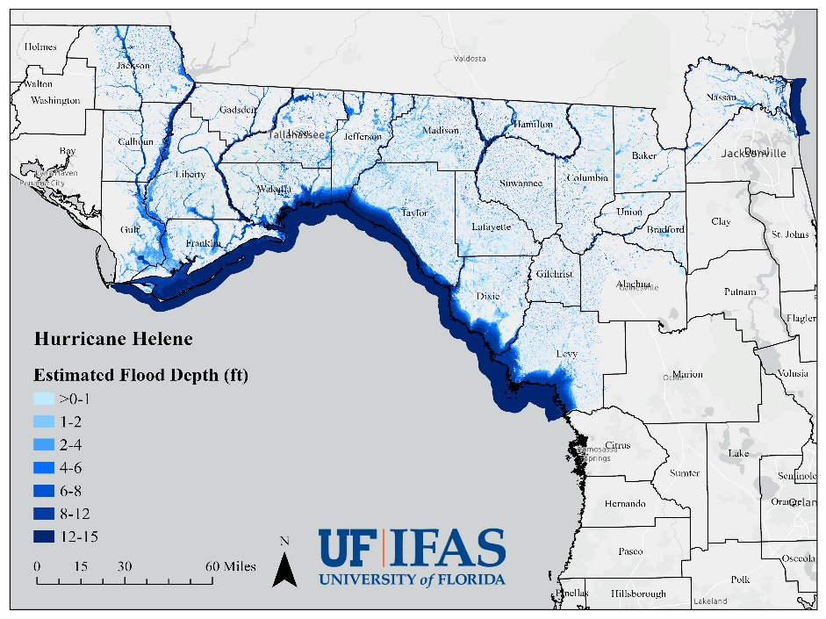
Hurricane Helene Characteristics
Figure 1. Wind swath pattern of Hurricane Helene as it impacted Florida.
Source: Geospatial data on the wind swath of Hurricane Helene are derived
from NOAA NHC (https://www.nhc.noaa.gov/gis/).
Figure 2. Cumulative precipitation totals in Florida (September 22-29, 2024).
Source: Precipitation data are derived from NOAA National Weather Service Quantitative Precipitation Estimate (QPE) Data (https://water.weather.gov/precip/download.php).
Figure 3. Estimated flood inundation depth caused by Hurricane Helene in Florida.
Source: Estimated flood inundation data are retrieved from Pacific Northwest National Laboratory’s Rapid Infrastructure Flooding Tool (https://open-rift-pnnl.hub.arcgis.com/documents/0dcc98b06bb8478c8ff708df796fe047/about).

Slide 15
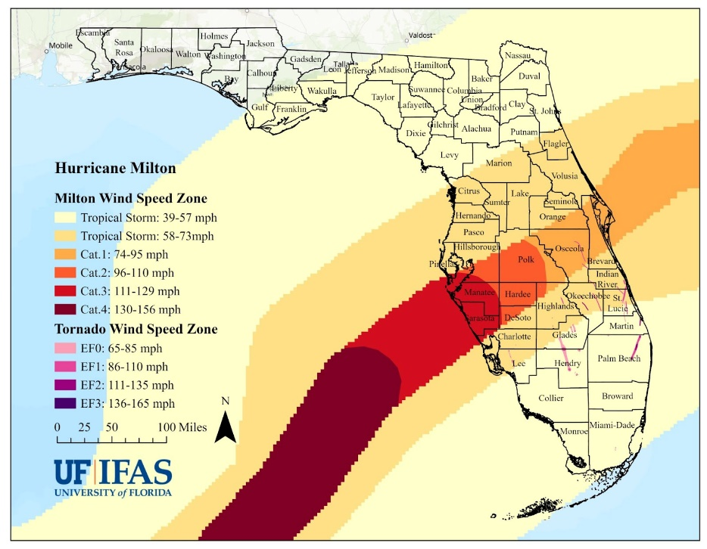
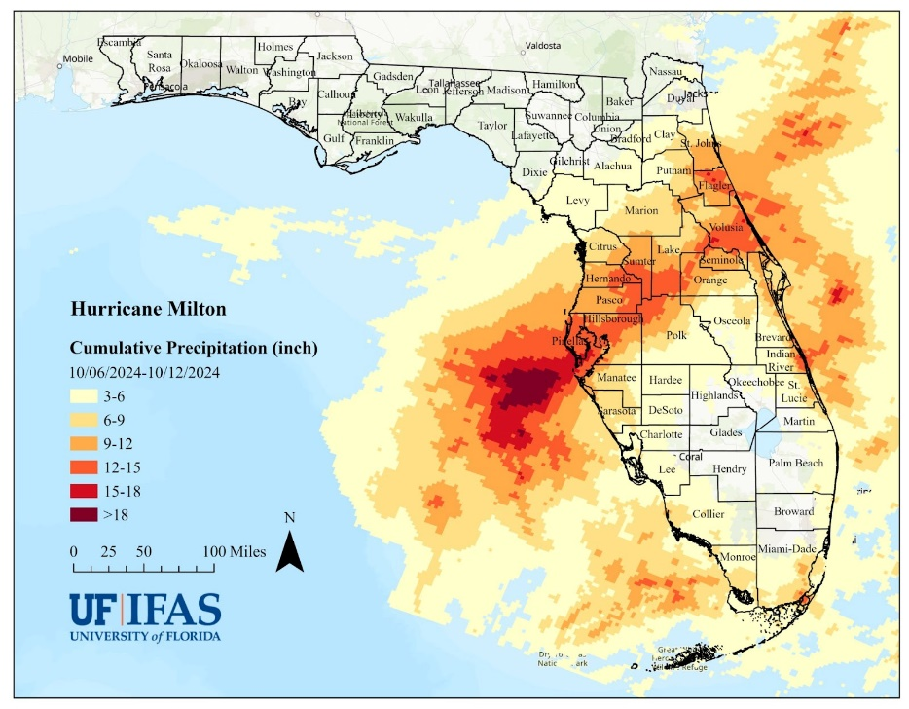
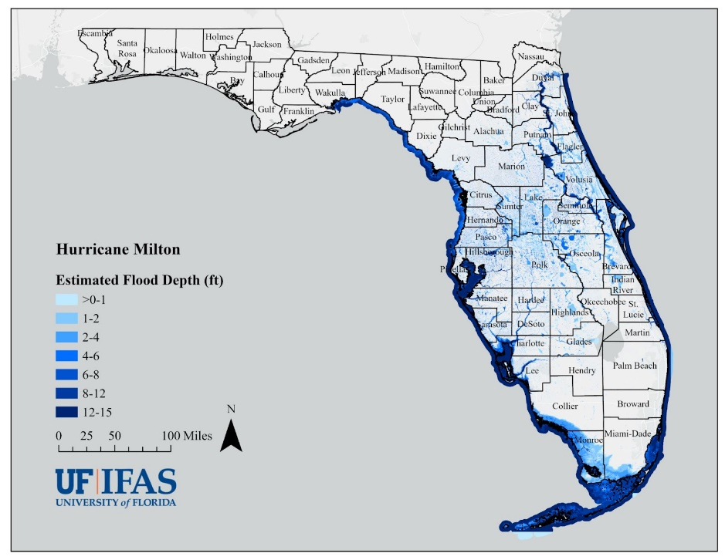
Hurricane Milton Characteristics
Figure 1. Wind swath pattern of Hurricane Milton as it impacted Florida.
Source: Geospatial data on the wind swath of Hurricane Milton are derived
from NOAA NHC (https://www.nhc.noaa.gov/gis/). Geospatial data on the wind swaths of tornadoes are derived from NOAA NWS Damage Assessment Toolkit (https://apps.dat.noaa.gov/StormDamage/DamageViewer/).
Figure 2. Cumulative precipitation totals in Florida (October 6-12, 2024).
Source: Precipitation data are derived from NOAA National Weather Service Quantitative Precipitation Estimate (QPE) Data (https://water.weather.gov/precip/download.php).
Figure 3. Estimated flood inundation depth caused by Hurricane Milton in Florida.
Source: Estimated flood inundation data are retrieved from Pacific Northwest National Laboratory’s Rapid Infrastructure Flooding Tool (https://open-rift-pnnl.hub.arcgis.com/datasets/6ad56f6b56014fbfb0c492379bd78eeb/about).

Slide 16
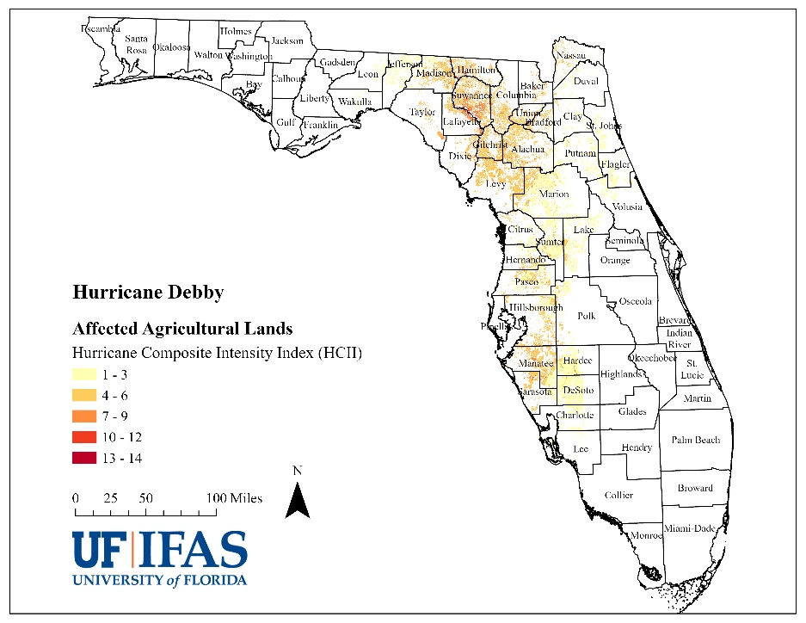
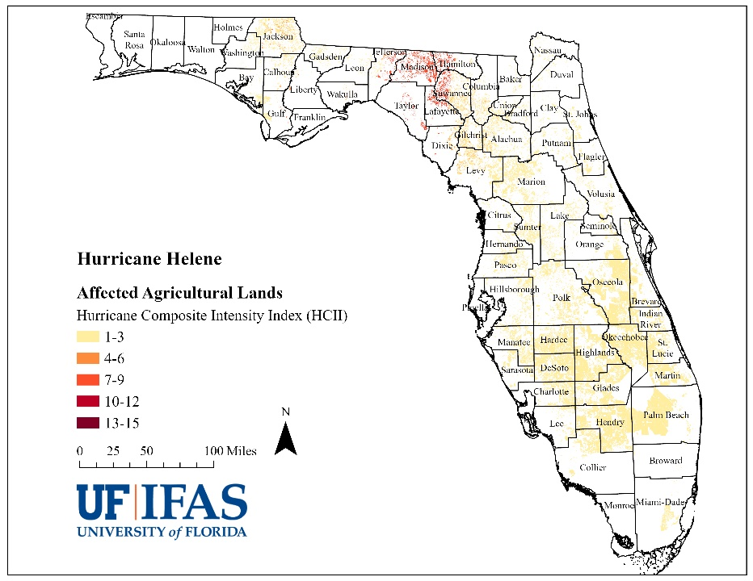
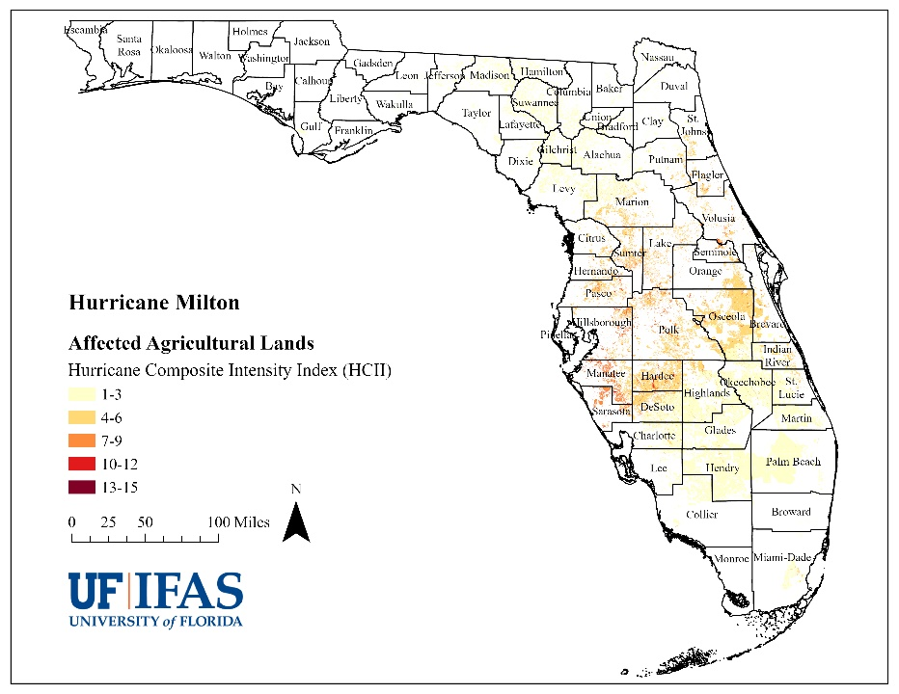
Florida Agricultural Lands Impacted in 2024
Hurricane Debby
Hurricane Helene
Hurricane Milton
~7 weeks
~2 weeks
Figure 4. Hurricane Composite Intensity Index (HCII) level for agricultural lands impacted by Hurricane Debby in Florida.
Figure 4. Hurricane Composite Intensity Index (HCII) level for agricultural lands impacted by Hurricane Helene in Florida.
Figure 4. Hurricane Composite Intensity Index (HCII) level for agricultural lands impacted by Hurricane Milton in Florida.
Over 2.2 million acres of agricultural lands that annually produce $3.17 billion in agricultural products affected
Around 48,000 acres ($83.30 million in annual production) experienced high-intensity weather conditions (HCII 10 – 15)
Over 6.1 million acres of agricultural lands that annually produce $8.74 billion in agricultural products affected
Around 18,000 acres ($33.24 million in annual production) experienced high-intensity weather conditions (HCII 10 – 15)
Over 5.7 million acres of agricultural lands that annually produce $8.66 billion in agricultural products affected
Around 38,000 acres ($44.24 million in annual production) experienced high-intensity weather conditions (HCII 10 – 15)
Source: The agricultural lands geospatial data are from the Florida Statewide Agricultural Irrigation Demand (FSAID) Agricultural Lands Geodatabase (ALG) developed by the Florida Department of Agriculture and Consumer Services (FDACS) (https://www.fdacs.gov/Agriculture-Industry/Water/Agricultural-Water-Supply-Planning).

Slide 17
Methodology for Estimating Agricultural Losses (cntnd.)
These production loss estimates are preliminary and might change as additional information specific to Hurricanes Debby, Helene, and Milton is collected.
Production loss estimates convey the percentage/value of annual production (for calendar year 2024 or, in the case of some crops, marketing year 2024-25) that has been lost due to Hurricanes Debby, Helene, and Milton.
Some crops have multiple growing seasons in Florida and others sell product year-round, which has been roughly accounted for in estimated loss percentage values.
Adjustments have been made to estimated loss percentage values to account for planting and harvesting progress for some commodity groups, but further adjustments might be made as information on early harvesting prior to the event, delayed planting, or the potential for growers to replant damaged or destroyed acreage is shared.
Losses that might occur in calendar year 2025, marketing year 2025-2026, or beyond are not assessed and would be “in addition to” these estimates.
The Low and High scenarios should be interpreted as low and high estimates on averages for the relevant commodity group and HCII zone and should not be interpreted as minimum and maximum values for individual producers or for commodity groups.
Production loss estimates do not include the value of stored inputs or stored harvested products that were damaged or destroyed nor does it include the value of damages to infrastructure (including perennial plantings and lost/deceased animals) that will require repair or replacement.
These estimates do not account for the fact that some crop losses might be eligible for or covered by crop insurance or other risk management tools available to producers.
A range of potential production losses is provided as opposed to point values to reflect the uncertainty that remains surrounding percentage production losses (for reasons provided above and others).

Slide 18
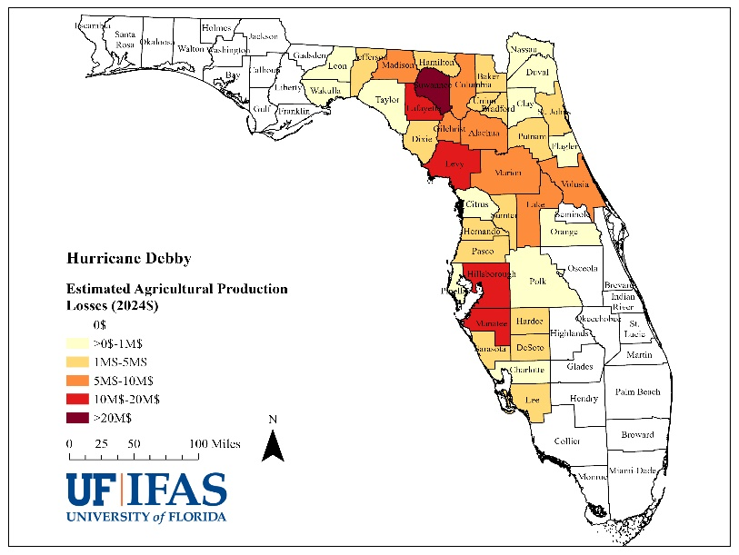
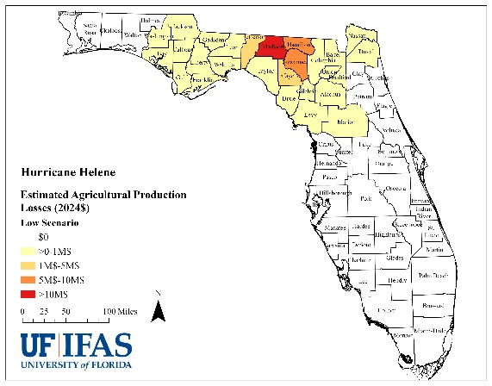
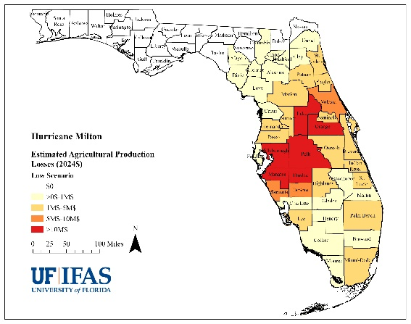
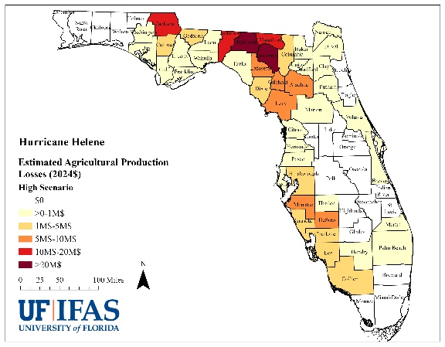
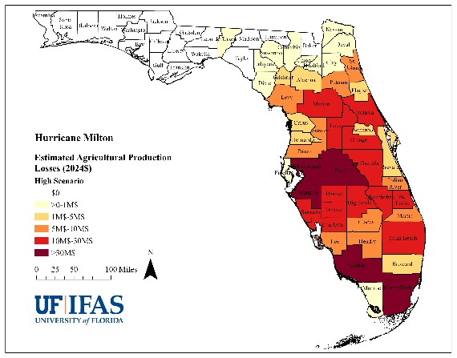
Estimated Agricultural Losses due to 2024 Atlantic Hurricane Season in Florida
Hurricane Debby
Hurricane Helene
Hurricane Milton
Agricultural Losses: ~$170 million
Agricultural Losses:
~$40.3 – $162.2 million
Agricultural Losses:
~$190.4 – $642.7 million
Highest losses in Big Bend, North Central, and SW peninsula regions
In terms of value, commodity groups with highest losses are Field & Row Crops and Animals & Animal Products
Highest losses in Big Bend and North Central regions with low level losses to high value crops in SW peninsula under the High Scenario.
In terms of value, commodity groups with highest losses are Field & Row Crops and Animals & Animal Products
Highest losses in SW and Central peninsula with low level losses to high value crops driving significant losses in southern counties under the High Scenario.
In terms of value, commodity groups with highest losses are Vegetables, Melons, & Potatoes and Greenhouse/Nursery
Cumulative agricultural production losses in Florida for the 2024 hurricane season are estimated to be between $402.3 million and $975.8 million.
**Results are preliminary and might change as additional information becomes available.**

Slide 19
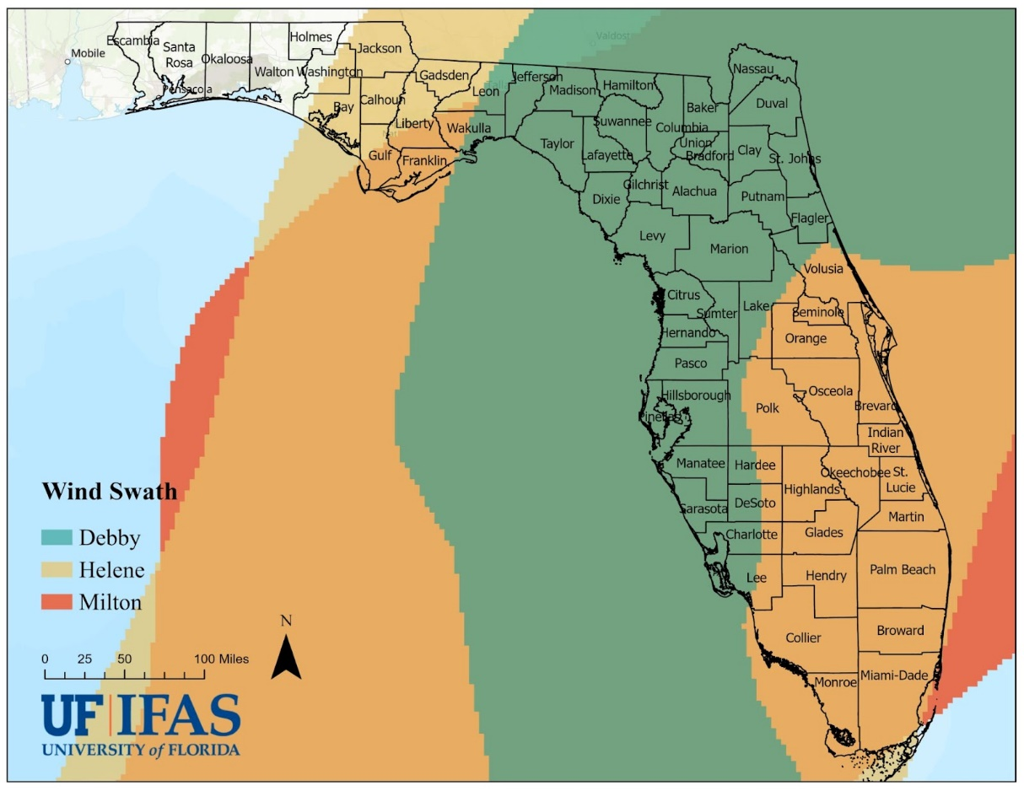
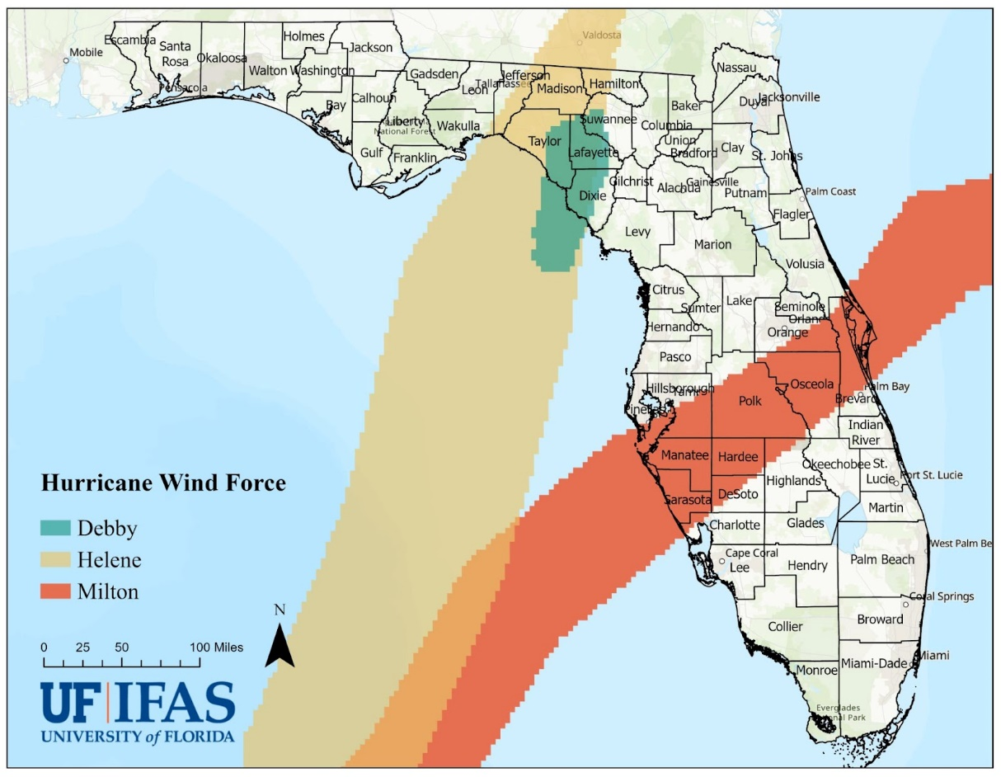
Compound Disasters: Florida Agricultural Lands Impacted by Multiple Hurricanes in 2024
Over 2.25 million acres of agricultural lands across 41 counties experienced at least tropical storm conditions during all three 2024 events (Hurricanes Debby, Helene, and Milton)
Top commodity groups affected in terms of acreage were Animals and Animal Products and Field and Row Crops
Over 71,000 acres of agricultural lands in Taylor, Lafayette, Dixie, and Suwannee counties were affected by hurricane conditions during both Hurricanes Debby and Helene
Recall that these regions also experienced Hurricane Idalia (August 2023, Big Bend region) and Hurricane Ian (September 2022, SW Peninsula region)
Source: The agricultural lands geospatial data are from the Florida Statewide Agricultural Irrigation Demand (FSAID) Agricultural Lands Geodatabase (ALG) developed by the Florida Department of Agriculture and Consumer Services (FDACS) (https://www.fdacs.gov/Agriculture-Industry/Water/Agricultural-Water-Supply-Planning).

Slide 20








Asset and production damage
Survey respondents reported damage to or destruction of the following types of agricultural assets:
Homes
Barns and storage structures
Livestock sheds and watering points
Greenhouse and other growing structures
Fencing (exterior and interior)
Irrigation systems
Conservation structures
Aquaculture structures and equipment
Honey bee boxes
Farm equipment (tractors, vehicles, greenhouse heating/cooling, etc.)
Perennial plantings
Survey respondents also reported damage to or destruction of stored harvested products and the following types of stored inputs:
Stored animal products (e.g., eggs, meat, milk)
Stored food fishes
Fertilizer, pesticides, and animal medicine
Seeds
Fish feed, fingerlings, aquatic medicine
Honey bee feed
Stored hay, millet, and feed grain
Bird scratch/feed
Photos courtesy of survey respondents.

Slide 21
What else is not included?
Labor and materials costs associated with event-specific preparations and clean-up
Impacts to timber/forestry
Timber/forestry impacts are assessed by the Florida Forest Service
Impacts to affiliated businesses throughout the supply chain
Impacts to upstream operations that might result from changes in purchasing behavior of impacted agricultural producers in Florida
Impacts to downstream operations that use Florida agricultural products in their processing, packaging, or manufacturing operations
Impacts to agricultural research and extension facilities
Damage to UF/IFAS Research and Education Centers (RECs) and other Research & Demonstration Sites across the State of Florida
Tree and debris removal at off-campus UF/IFAS and FAMU facilities
Losses incurred on active research projects (replanting of crops, additional supplies, temporary labor, etc.)
Rental of modular facilities for displaced UF/IFAS or FAMU personnel
Impacts to commercial fishing and working waterfronts
Impacts to commercial fishing and working waterfronts are often assessed by NOAA Fisheries or the Florida Fish and Wildlife Conservation Commission (FWC)
Impacts to natural resources and ecosystem services

Slide 22
Data Tools for Threat Assessment

Slide 23


UF/IFAS EIAP Data Platform
https://ffav-ufl.hub.arcgis.com/
Providing information relevant to diverse audiences on the multiple climatic, biological, social, and economic contexts they function in is complex and necessitates a data-driven approach.
Innovations in and use of interdisciplinary technologies (webGIS, AI, BI, etc.) can help.
UF/IFAS EIAP Data Platform is an initial output of an effort to deepen our understanding of
Interactions between UF/IFAS Extension and its stakeholders
Local social, economic, and demographic conditions within which these interactions take place.
Continued development to offer a permanent and comprehensive data visualization system supporting communication and decision-making within and outside of UF/IFAS Extension.
Notes:
In addition, maps and other visuals can be used to tell compelling stories that different types of audiences can understand and remember, thus facilitating communication between people with different backgrounds and perspectives; sound and informed choices require effective communication that reaches the multiple audiences involved in planning and decision-making processes (Fischhoff, 2013; Wright, 2016).
Geographic Information Systems (GIS) environments are one of the potential solutions for improving communication among stakeholders and ensuring that everyone is communicating in the same contextual framework. GIS facilitates the visualization of maps and data, and queries on those maps, data, and associated metadata. Those types of interaction with the data can influence decision makers, affect policy, and inform the general public.
While many scientific endeavors often fail to make new knowledge accessible to stakeholders, it has been suggested (e.g., Lecours 2017) that the use of GIS to encourage dynamic interaction with multiple maps could help, at least partly, to address this issue. In fact, behavioral experiments have shown that the use of GIS to analyze and interpret data and maps can improve decision making (Crossland et al., 1995). GIS-based spatial decision support tools are considered among the best options for informing and assisting decision making (Andersen et al. 2004).
Ultimately, this effort has the potential to change the ways that UF/IFAS Cooperative Extension Administration, faculty, and staff collaboratively engage to conduct and operationalize research and extension programs in Florida.

Slide 24

Agricultural Lands https://ffav-ufl.hub.arcgis.com/pages/cropprod

Slide 25





Florida’s Agriculture and Food System Fast Facts

Slide 26



New UF/IFAS Disaster-Related Resources

Slide 27


Opportunities to learn more
https://www.buzzsprout.com/2375738
https://piecenter.com/pie-academy

Slide 28

Opportunities to learn more

Slide 29
Thank You!
Dr. Christa D. Court
ccourt@ufl.edu
UF/IFAS Economic Impact Analysis Program (EIAP)
https://go.ufl.edu/eiap
UF/IFAS Economic Impact Analysis Program (EIAP)
https://go.ufl.edu/disasters
UF/IFAS EIAP Hurricane Debby Resources
https://go.ufl.edu/DebbyAgImpacts2024
UF/IFAS EIAP Hurricane Helene Resources https://go.ufl.edu/HeleneAgImpacts2024
UF/IFAS EIAP Hurricane Milton Resources
https://go.ufl.edu/MiltonAgImpacts2024
Photo courtesy of survey respondent.

Slide 30



Slide 31


Florida Agricultural Baseline Database
Production Loss
Crops (distribution, acreage, value per acre, seasonality)
Field crops, hay, sugarcane, citrus, fruit and tree nuts, greenhouse/nursery, vegetables, melon, and potatoes
Animal and Animal Products (distribution, acreage, county-level value/heads per acre)
Inland aquaculture, marine aquaculture, marine shellfish, tropical fish,
Grazing land, pastureland, cattle feeding operations, horse farm, poultry, bees, specialty farm, gator farm
Asset Damage
Agricultural building (distribution, footprint, county-level value per acre)
Machinery and equipment (county-level value per acre)
Irrigation systems (type, distribution, served acreage)
Production Damage

Slide 32


Crops - Distribution and Acreage
FDACS Florida Statewide Agricultural Irrigation Demand Agricultural Lands Geodatabase
(FSAID ALG)
Resolution | Parcel-level
Data Type | Polygon shapefile
Accessibility | Public
Release Date | Annual, two years later
Latest Version | 2022
Crop growing period | All year
Agriculture category | Crop, Aquaculture, Livestock
Number of crop types | 14 categories, 153 types (2022)
Total agricultural acreage | 7,480,860 (2022)
Information | Commodity type, acreage, irrigation system, rainfall, water demand, etc.
Advantages:
Cover all the crops through the year
More detailed crop types
Include livestock data
More agriculture-related information
Limitation:
Data latency
EIAP Data Platform – Florida Crop Production Page
https://ffav-ufl.hub.arcgis.com/pages/cropprod
Data Source: https://www.fdacs.gov/Agriculture-Industry/Water/Agricultural-Water-Supply-Planning

Slide 33
Crops - Value Per Acre
USDA National Agricultural Statistics Service (NASS) Annual Estimates for Florida
Value Per Acre = Price Received ($/unit) * Yield (unit/acre)
2019 - 2023, 5-year average
Crop | Value Per Acre in 2023 Dollars |  |  |  |  | 5-Year Average in 2023 dollars
 | 2019 | 2020 | 2021 | 2022 | 2023
Avocados | $ 4,624.22 | $ 3,067.01 | $ 3,024.22 | $ 3,384.77 | $ 2,757.30 | $ 3,371.51
Beans, Snap | $ 3,093.94 | $ 3,198.81 | $ 2,314.90 | $ 3,124.31 | $ 3,404.80 | $ 3,027.35
Blueberries, Tame | $ 14,741.19 | $ 11,851.63 | $ 14,561.92 | $ 15,635.17 | $ 25,585.00 | $ 16,474.98
Cabbage | $ 8,481.70 | $ 7,907.45 | $ 12,079.20 | $ 9,919.04 | $ 11,010.00 | $ 9,879.48
Corn, Grain | $ 832.61 | $ 910.16 | $ 1,172.64 | $ 1,255.75 | $ 853.20 | $ 1,004.87
Cotton, Upland | $ 621.00 | $ 446.79 | $ 675.04 | $ 757.85 | $ 451.66 | $ 590.47
Cucumbers | $ 4,116.57 | $ 4,395.16 | $ 5,764.01 | $ 5,438.34 | $ 5,418.00 | $ 5,026.42
Grapefruit | $ 3,119.50 | $ 2,701.98 | $ 3,467.11 | $ 3,804.53 | $ 3,070.50 | $ 3,232.72
Grapefruit, Red Seedless | $ 3,138.79 | $ 2,768.16 | $ - | $ - |  | $ 1,476.74
Grapefruit, White Seedless | $ 3,053.32 | $ 1,951.57 | $ - | $ - |  | $ 1,251.22
Hay | $ 515.85 | $ 537.40 | $ 390.13 | $ 434.65 | $ 434.00 | $ 462.41
Hay, (Excl Alfalfa) | $ 515.85 | $ 537.40 | $ 390.13 | $ 434.65 |  | $ 469.51
Melons, Cantaloup | $ 4,774.49 | $ 9,484.75 | $ 8,325.61 | $ - |  | $ 5,646.21
Melons, Watermelon | $ 7,421.49 | $ 7,276.99 | $ 8,321.74 | $ 8,559.97 | $ 9,272.00 | $ 8,170.44
Oranges | $ 2,730.94 | $ 2,070.31 | $ 1,728.27 | $ 1,376.41 | $ 495.90 | $ 1,680.37
Oranges, Mid & Navel | $ 2,355.50 | $ 1,872.51 | $ 1,637.21 | $ 1,453.90 | $ 472.70 | $ 1,558.36
Oranges, Valencia | $ 3,003.56 | $ 2,210.92 | $ 1,796.89 | $ 1,329.97 | $ 506.80 | $ 1,769.63
Peanuts | $ 899.77 | $ 816.29 | $ 944.91 | $ 1,124.06 | $ 903.04 | $ 937.61
Peppers, Bell | $ 22,239.72 | $ - | $ 14,790.21 | $ 22,638.25 | $ 13,524.00 | $ 14,638.44
Potatoes | $ 6,900.22 | $ 6,139.38 | $ 5,438.63 | $ 5,815.51 | $ 9,810.00 | $ 6,820.75
Squash | $ 5,933.66 | $ - | $ 4,471.32 | $ 4,879.03 | $ 5,300.00 | $ 4,116.80
Strawberries | $ 45,659.82 | $ 32,337.01 | $ 40,728.83 | $ 38,367.64 | $ 30,870.00 | $ 37,592.66
Sugarcane, Sugar | $ 1,850.38 | $ 2,025.12 | $ 2,055.39 | $ 2,158.31 |  | $ 2,022.30
Sweet Corn | $ 4,064.15 | $ 5,457.74 | $ 5,312.46 | $ 4,996.15 | $ 5,600.00 | $ 5,086.10
Tangerines | $ 2,388.73 | $ 3,079.09 | $ 2,471.69 | $ 2,745.30 | $ 2,320.47 | $ 2,601.05
Tomatoes | $ 16,876.23 | $ 19,081.75 | $ 13,612.06 | $ 13,028.80 | $ 16,530.00 | $ 15,825.77

Slide 34



Crops - Seasonality
Resources
UF/IFAS annual Vegetable Production Handbook of Florida
FDACS – information on typical harvest periods for Florida crops
USDA-NASS Usual Planting and Harvesting Dates for U.S. Field Crops
EIAP Data Platform – Florida Crop Seasonality Page
https://ffav-ufl.hub.arcgis.com/pages/cropseason
Note: not all the results are shown here

Slide 35


Livestock and Aquaculture
Distribution and Acreage
FSAID ALG layer (Livestock and Inland Aquaculture)
FDACS Shellfish Harvesting Area and Aquaculture Leases Records (Marine Aquaculture)

Slide 36

Livestock and Aquaculture
County-level Value Per Acre
2022 USDA Census of Agriculture
County-level Inventory and Sales of Livestock and Aquaculture
Beef Cattle
Dairy
Equine
Poultry
Bees

Slide 37


Assets - Agricultural Building & Value
2017 USDA Census of Agriculture
County-level value per acre of farmland and buildings
Ratio of “improvements value” and “land value” of Florida agricultural parcels
Florida Agriculture Building Footprint Geospatial Data
Extracted from USA Structures database
Greater than 450 square feet
Building area, height
Building occupancy type

Slide 38


Assets - Machinery and Equipment
FSAID Irrigation Lands Geodatabase
2022 USDA Census of Agriculture
County-level farm and machinery and equipment data
Irrigation System | Acreage
Gravity Systems | 891,338
Micro Spray | 500,308
Center Pivot / Lateral Move | 230,790
Drip | 151,997
Impact Sprinkler | 31,190
Container Nursery | 29,807
Traveling Gun | 28,310

Slide 39

Damage and Loss Methodology
Damage
The replacement or repair cost of totally or partially destroyed physical assets and stocks.
Loss
Changes to economic flows due to a disaster
Production
Stored production and inputs; Actual production.
Assets
Facilities, machinery, tools, infrastructure related to agricultural production
Food and Agriculture Organization
of the United Nations
Crops
Livestock
Forestry
Aquaculture
Fisheries

Slide 40




Damage
Loss
Production
Production Loss
Asset Damage
Production Damage
Asset

